Slide 1
FES Perspective
E.J. Synakowski
Associate Director, Office of Science
Fusion Energy Sciences
Presented to the Fusion Energy Sciences Advisory Committee
January 31, 2013

Slide 2
FES updates

Slide 3
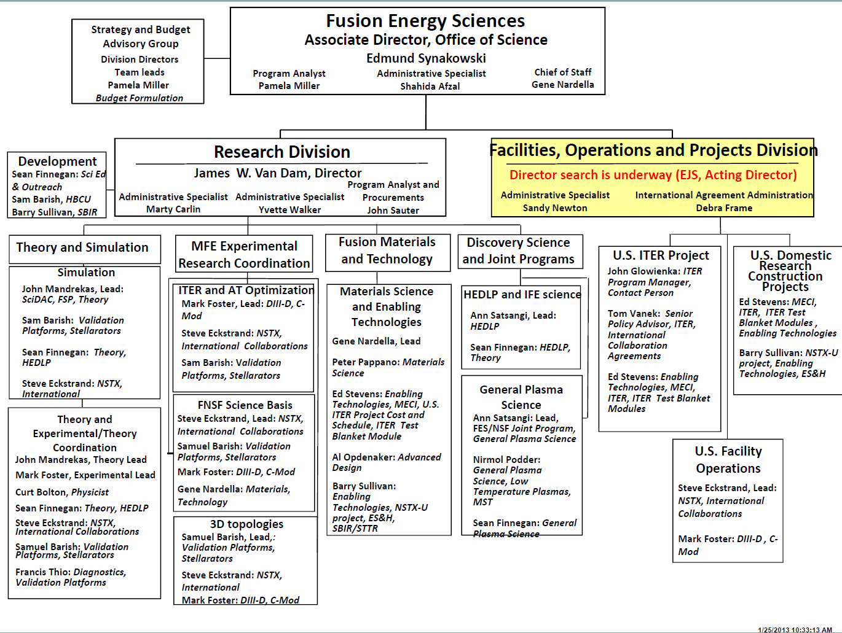
Hiring process underway for new FOP Division Director Position
Notes:
What used to be the ITER and International Division (led by Dr. Michael Roberts) was re-organized in 2012 as the Facilities, Operations, and Projects (FOP) Division.

Slide 4
Conservative financial stance
All SC program offices were given 47% of CR funding for the first six months of FY 2013
Continuing Resolution funding = lowest of FY 2012 appropriated budget, Administration’s FY 2013 budget request, House mark, and Senate mark
FES allocated funds so as to try to avoid irreversible impacts on programs
A conservative approach has been adopted until resolution of the FY 2013 budget and the sequestration possibility
Near end of FY 2012, program managers encouraged PI’s to save and carry over funds into FY 2013
With solicitations for which proposals have been reviewed, renewal awards have been processed but brand-new awards have been put on hold
FY 2014 budget roll-out (usually first Tuesday of February) will be delayed

Slide 5
Solicitations for FY 2013 funding
Solicitation | Status | FY 2013 proposed $ | FES Point of Contact(s)
Theoretical Research in Magnetic Fusion Energy Science | Reviews completed; new awards on hold | $4.5M/yr | John Mandrekas
Collaborative Research in Magnetic Fusion Energy Sciences on International Research Facilities | Reviews completed; awards pending budget resolution | $6M/yr | Steve Eckstrand
Laboratory Opportunities in Basic Plasma Science | Reviews completed; new awards on hold | $1.4M/yr | Nirmol Podder
Diagnostic Systems for Magnetic Fusion Energy Sciences | Completed | $3M/yr | Francis Thio
Collaborative Research in Magnetic Fusion Energy Sciences on the NSTX Upgrade | In process | $1.7M/yr | Steve Eckstrand
High Energy Density Laboratory Plasma Science for Inertial Fusion Energy | In process | $5M/yr | Ann Satsangi, Sean Finnegan
NSF/DOE Partnership in Basic Plasma Science and Engineering | In process | $2M/yr | Nirmol Podder, Ann Satsangi, Sean Finnegan
SBIR/STTR Phase I | Completed | TBD | Depends on proposal area
High-Energy-Density Laboratory Plasma Science | In process | $2M/yr | Sean Finnegan, Ann Satsangi
Office of Science Early Career Research Program | In process | TBD | Depends on proposal area
Research in Innovative Approaches to Fusion Energy Sciences | To be issued Spring 2013 | FY 2014 funding (TBD) | Sam Barish

Slide 6
FESAC status

Slide 7
FESAC miscellaneous
FESAC membership will be rotated soon
SC guidance is to have regular rotation of the members of Federal Advisory Committees; FESAC is due for such rotation
Review and approval of new membership nomination package is underway
Terms of current FESAC members are being extended to June 3
This allows time for approval of the new members
It also allows the new Science Facilities Prioritization charge (and any other potential charges) to be handled by FESAC as currently constituted
Given advances in information technology and tight travel budgets, an upcoming FESAC meeting might be held as a webinar

Slide 8
FESAC charge on MFE Program Priorities

Slide 9
FESAC activity to assess MFE priorities is completed
Charge was issued in mid-April 2012
We look forward to the presentation of the report at this FESAC meeting
The charge was a difficult one, albeit very important
The circumstances: a constrained, difficult budget at a critical time in the program’s evolution
Given the nature of the charge, the size of the community, and its tight-knit character, special care was required for managing potential conflicts of interest
Sincere thanks to all of the members of this FESAC panel, chaired by Bob Rosner

Slide 10
New FESAC charge on Science Facilities Prioritization

Slide 11
New charge to SC Federal Advisory Committees
DOE established the following goal for the Office of Science:
Goal Statement: Prioritization of scientific facilities to ensure optimal benefit from Federal investments. By September 30, 2013, formulate a 10-year prioritization of scientific facilities across the Office of Science based on (1) the ability of the facility to contribute to world-leading science, (2) the readiness of the facility for construction, and (3) an estimated construction and operations cost of the facility.
SC therefore requested the Federal Advisory Committees for its six program offices to identify and characterize high priority new facilities and upgrades according to two criteria:
The ability of the facility to contribute to world-leading science in the next decade (2014 – 2024)—(a) absolutely central; (b) important; (c) lower priority; and (d) don’t know enough yet.
The readiness of the facility for construction— (a) ready to initiate construction; (b) significant scientific/engineering challenges to resolve before initiating construction; and (c) mission and technical requirements not yet fully defined.
To meet the compressed timetable, your final report is needed by March 22, 2013

Slide 12
We have to pay close attention to DOE practices for non-FACA panels regarding COI
From DOE General Counsel:
DOE General Counsel advises that the Department's practice is to hold subpanels/subcommittees, to the same Conflict of Interest (COI) rules that govern FACA committees. This means that a member may participate in policy discussions affecting the employer of a member or spouse of a member but may not participate in discussions directly pertaining to a facility or specific program of the employer of a member or spouse of a member. Your task to evaluate each user facility will cause your members to recuse him or herself because such discussions will affect each user facility directly. These discussions cannot be regarded as policy discussions. These rules apply to all members regardless of whether the member is a member of the parent FACA committee.
When a member is recused, it ensures that a subpanel/subcommittee does not consider information or lines of argument pertaining to a facility or program where a subpanel/subcommittee member presenting the information or arguments will be viewed as having a bias because of an employment relationship with the institution. Therefore, those members who are recused should actually step out of the room during the discussions from which they are recused.
This will be discussed at tomorrow’s subpanel meeting (John Sarff, chair)

Slide 13
Step 1: FES provides list of proposed new facilities and upgrades
Sent to FESAC (and posted on the FES web page for FESAC http://science.energy.gov/fes/fesac/reports):
DIII-D National Fusion Facility Upgrade
Materials Facilities Initiative
Fusion Nuclear Science Facility (FNSF)
QUASi-Axisymmetric Research (QUASAR) Experiment
Comments:
No implied priority among these four proposals
The number of proposals was intentionally kept small

Slide 14
Step 2: FESAC seeks input from science community
FES guidance to FESAC:
FESAC may add to or subtract from the FES starting proposals; the final FESAC recommendations should be realistic and focused
ITER (an international agreement) is not to be considered in this activity
NSTX-Upgrade is already well underway, hence also not to be considered
Facilities whose cost is <$100M may be considered
Coherent bundles of upgrades or of smaller facilities may be considered
A FESAC meeting will likely be scheduled in mid-March to receive the subpanel’s report
Sincere thanks to John Sarff (chair), Don Rej (vice chair), and the other members who have agreed to serve on this subpanel

Slide 15
DIII-D National Fusion Facility Upgrade
Contributions to world-leading science | Readiness for construction
(b) Important The upgrade package will provide access to new physics regimes, allowing investigations of: physics relevant to burning plasmas (including ITER R&D issues) conditions required for steady-state operation 3D optimization of the tokamak concept innovative divertor concepts disruption mitigation technical basis for FNSF design choices | (a) Ready to initiate construction Conceptual designs have been developed, with no technical barriers identified for the upgrades: additional magnetic field perturbation coils increased electron cyclotron heating and current drive increased off-axis neutral beam power toroidally steerable neutral beam disruption quench systems advanced divertor new diagnostic capabilities

Slide 16
Materials Facilities Initiative
Contributions to world-leading science | Readiness for construction
(a) Absolutely central The initiative would provide two cost-effective test facilities that can replicate extreme fusion conditions for the first time, providing information for the design of FNSF and allowing investigations of the behavior of materials under: irradiation by 14 MeV neutrons irradiation by combined high heat and particle fluxes | (a) Ready to initiate construction Some power source R&D is required

Slide 17
Fusion Nuclear Science Facility (FNSF)
Contributions to world-leading science | Readiness for construction
(a) Absolutely central An FNSF would provide the first-ever fully integrated fusion nuclear environment uniquely suited to investigate and understand: fusion plasma-material interactions radiation effects on materials tritium fuel sustainability power extraction full remote handling operations | (b) Significant scientific/engineering challenges to resolve before initiating construction Significant scientific and engineering challenges remain to determine and develop: optimum magnetic configuration auxiliary heating and current drive systems operating scenarios and control systems structural material and plasma-material interaction data from Materials Test Facilities

Slide 18
Quasi-Axisymmetric Stellarator Research (QUASAR) Experiment
Contributions to world-leading science | Readiness for construction
(b) Important This would be the world’s first stellarator designed on the basis of quasi-axisymmetry, allowing investigations of: operating limits neoclassical and turbulent transport reduction passive control of islands and instabilities power and particle exhaust | (a) Ready to initiate construction Some components (3D coils, vacuum vessel, and toroidal field coils) have already been fabricated, and assembly has been demonstrated

Slide 19
Step 3: With FESAC input, SC Director will finalize list
This new list of prioritized science facilities will be the successor to Facilities for the Future of Science: A Twenty-Year Outlook (2003)
The 2003 report received has been highly visible. A number of the top ranked facilities have gone forward.

Slide 20
Thank you

